Slide 1
Fight, Flight, Freeze, Fawn, Fooey
Project Management of Other People’s Stress Sean D Barrett, 120CPM, PMP, PMI-ACP
http://www.linkedin/in/seandbarrett
sean.barrett@120VC.com

Slide 2
http://news.sutterhealth.org/files/2013/05/stress-level-smaller.jpg

Slide 3
It’s All in Your Head
Fight, Flight, Freeze, Fawn, Fooey

Slide 4
Amygdala Hijack
An immediate, overwhelming emotional response, disproportionate to the actual stimulus because it triggered a more significant emotional threat
Amygdala
Hippocampus

Slide 5
Four Fs
One who tends to think that
power and control create safety
perfection creates safety
solitude creates safety
surrender creates safety
Is more likely to
Fight!
Flee!
Freeze!
Fawn!

Slide 6
Scenario
Fight, Flight, Freeze, Fawn, Fooey

Slide 7
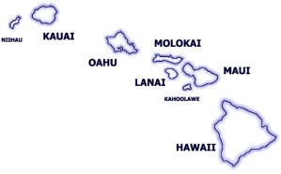
Dramatis Personae
Portfolio Manager: Alice
Program Manager: Bruce
Project Manager: Carol
There is no problem so bad you can't make it worse. —Chris Hadfield

Slide 8
http://www.3d-hdwallpaper.com/bulk_images/desktop-hd-saber-tooth-tiger-pics.jpg

Slide 9
PMs Have Charms to Soothe the Wild Exec
PMs Must
To Do That, They Must
Avoid triggering an “amygdala hijack”
Lead the executive through the situation
Ensure that decisions are made that will lead to the project’s success
Understand that perception is reality
Follow the First Rule of Reporting
Take a “Can Do” approach

Slide 10
Perception Is reality
Fight, Flight, Freeze, Fawn, Fooey

Slide 11
Project Management is Risk Management
Be Cool
Be perceived as creating safety — able to handle the risk (“threat”)
Be perceived as being safe — not a risk (“threat”)
No Off-the-Record Venting
Nothing is “off the record” — the mic is always live!
Never allow any doubt that you can handle any risk
Communicate to Lead
Communicate only to move your project toward completion

Slide 12
The First Rule of Reporting: No Jargon
Fight, Flight, Freeze, Fawn, Fooey

Slide 13
Effective Communication
Be Brief
Project managers communicate to lead their projects to completion
Any communication that leads to confusion is failed communication
Be Brilliant
Use clear business terms, not PM mumbo-jumbo
If you aren’t measuring it, you aren’t managing it
Report fact, not feeling
Be Gone
Chatting with executives is not delivering scope

Slide 14
Project Management Jargon
Constraint
Critical Path/Task
Decomposition
Duration/Effort
Event chain methodology
Float/Slack
Lag
Mitigation
Progressive Elaboration
Project Network Diagram
RA(S)CI Chart
RADIO/IRAAD List
Wideband Delphi

Slide 15
What’s Your Status?

Slide 16
What’s Your Status?

Slide 17
Health Definitions – Task
Task Health
Red – Overdue
Finish Date: 4 May
Today: 5 May
(Client’s definition: when you know you will miss go-live)
Yellow – not yet due, but running late
Start Date: 4 May– Finish Date 6 May
Today: 5 May– 15% done
(Client’s definition: when go-live date is in jeopardy)
Green – not Yellow or Red
Project Health
The health of the worst task … that is on the critical path

Slide 18
Pop Quiz: what is the “Critical Path”?
The list of all tasks considered critical to the delivery of the project
The sequence of scheduled activities that determines the duration of the project
The fastest way to get to the restroom

Slide 19
Critical Path and Slack

Slide 20
Can Do
Fight, Flight, Freeze, Fawn, Fooey

Slide 21
What Can Be Done — Not What Cannot
It can be accomplished (with time and money)
I want the Moon. And I want it in seven years. —Project Sponsor, 12 Sep 1962
“Roger, Tranquility. We copy you on the ground. You got a bunch of guys about to turn blue. We're breathing again.” —CAPCOM, 20 Jul 1969
Identify obstacles — and their solutions
Discuss with your team, not your executives
Project managers are paid to accomplish goals, not to find reasons they can’t
Communicate only solutions

Slide 22
Summary
Fight, Flight, Freeze, Fawn, Fooey

Slide 23
The Perpetual Pleistocene: Our Brains Haven’t Been Upgraded for Over 200,000 Years

Slide 24
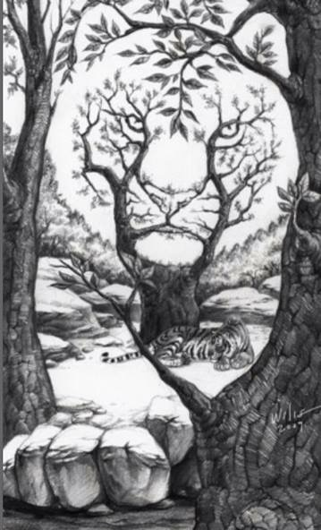
The Tiger is an Illusion
Fear, uncertainty, and doubt are emotionally contagious and make it hard to think
Manage the emotional space of a situation—mirror the attitude you want to see

Slide 26
Eliminate Stress by Eliminating Danger Don’t fight; be calm Don’t flee; be fearless Don’t freeze; be confident Don’t fawn; be irreverent
Sean D Barrett, 120CPM, PMP, PMI-ACP
http://www.linkedin/in/seandbarrett
sean.barrett@120VC.com

